Slide 1
Difference between
Type - I and Type - II
Hypervisor
Cloud Computing Lecture 24
Breakout Room No 4

Slide 2
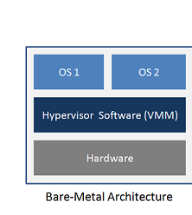
Type - I Hypervisor
Type - I Hypervisor is installed on top of Hardware directly.
Its is called as “ Bare-Metal ” hypervisor.
In terms of scalable usage, type - I is most suited as it is easily scalable.
In terms of enterprise usage, type - I is the way to go.
Type - I requires hardware acceleration to work directly on top of hardware.
eg: XEN / Ciitrix Xen Server, Red Hat Enterprise Virtualization, Microsoft Windows Server 2012 Hyper-V etc.

Slide 3
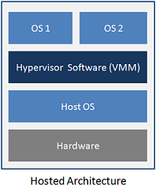
Type - II Hypervisor
Type - II Hypervisor is installed on top of an operating system.
It is called as hosted Hypervisor
In terms of scalable usage, type - II is not suited as it is installed on top of another OS.
.Type - II is mainly used for personal and small deployments.
Type - II uses hardware acceleration if the host OS provides the same.
eg: VirtualBox, VMware Player and VMware Workstation, Oracle Virtualbox etc

